Slide 1
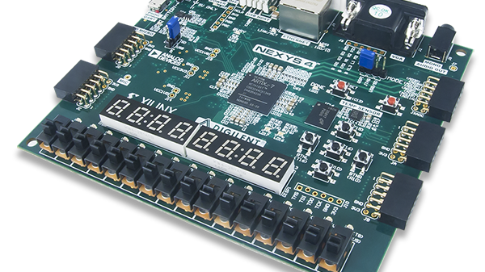
Lab 3
Group_D:
Laurice Sattouf
Choi Tim Anthony Young
Dimitri Garcia
Professor:
Mohamed El-Hadedy
California Polytechnic State University Pomona, California

Slide 2
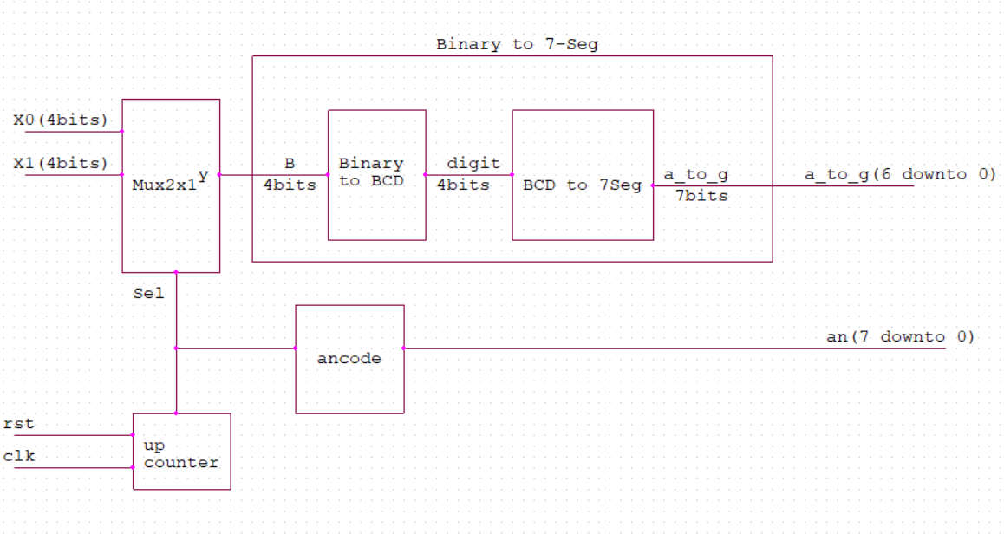
Assignment
Design binary to BCD converter unit that takes four inputs and produce BCD values from (0-9).
Design a 7SEG decoder.
Use two units of the BCD to display the results.
Define all possible corner cases using a testbench.

Slide 3
Coding Steps
Designing Binary to BCD unit:
To achieve this task, we created the design using combinational circuit and K-maps, where our input is Binary, and the output is BCD from 0 to 9:
2. BCD to 7-segment Decoder:
The board we are using to perform this lab, Nexys A7-100T, has 7-segment display with common anode as we could see in Figure (2). Therefore, the segment will be on when logic “0” is applied.
3. Using two displays to show results:
To enable a specific Display from the 8 Display provided on the board, we used top_an that selects which display will be on. We are asked to turn on Display 0 and 4.

Slide 4
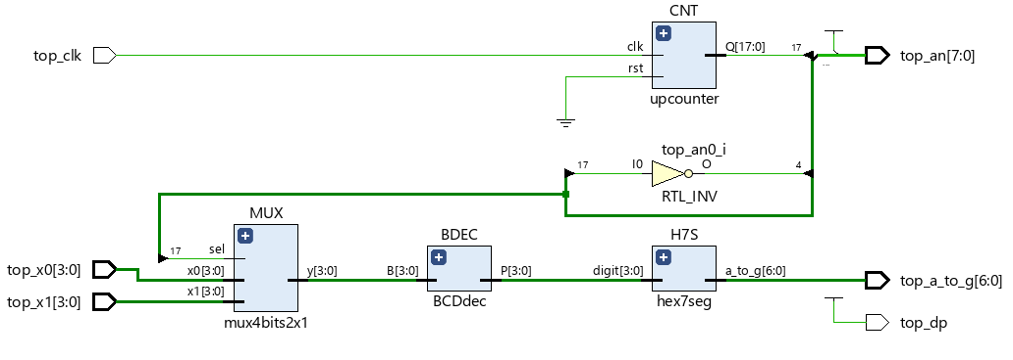
Schematic

Slide 5
Power and Resources

Slide 6

Work Distribution
We had a meeting to brainstorm and explain the main idea of the lab, and we created the schematic so that everyone would work individually to achieve the most optimized design.
We had a zoom meeting to choose the design with less power consuming, then we were able to demo our implemented design and cover all the corner cases.
Documentation and reports were evenly distributed, and it covered all the steps of our successfully implemented design.

